Slide 1
How sensitive are NTTA results to changing methodology? An example from the US
Gretchen Donehower
University of California at Berkeley
Thursday, November 8, 2012
European Time Use and NTA Workshop
Institute for Futures Studies, Stockholm, Sweden

Slide 2
Outline
NTA and gender: what, why and how
Review current methodology, major method alternatives and how to evaluate them
Review results under different methods
Recommendations based on US example (n=1!)

Slide 3
NTA and Gender
What
Measure economic activity by age AND gender
Include productive activity not traded in the market, not measured in GDP
11 countries actively working, more will start in 2013
Why
Equity – is it fair?
Efficiency – is it the best use of human resources?
Measure true cost of dependency and human capital investment
How
Estimate NTA by gender
Add National Time Transfer Accounts (NTTA): use time use surveys to add “household production”

Slide 4
Gender in NTA
National Time
Transfer Accounts
National
Transfer Accounts
Identify household production activities in TU survey (expansive definition)
Calculate single-sex NTA
Count time spent, including multi-tasking (50/50 for work overlap, 100 for leisure overlap)
Calculate age profiles by sex using same NTA methodology
Estimate per capita age profile of household production
Impute consumption equally to those in target age group
Adjust two-sex age profiles at each age to be consistent with single-sex profiles
Estimate transfers removing consumption of own-produced activities
Attribute a wage to each type of activity (specialist replacement , with adjustments for quality and fringe benefits)

Slide 5
Gender in NTA
National Time
Transfer Accounts
National
Transfer Accounts
Restrictive definition
Identify household production activities in TU survey (expansive definition)
Calculate single-sex NTA
No multi-tasking
Count time spent, including multi-tasking (50/50 for work overlap, 100 for leisure overlap)
Calculate age profiles by sex using same NTA methodology
Use regression instead of EAC weights
Estimate per capita age profile of household production
Change definition of household head
Data-driven imputation (regression)
Impute consumption equally to those in target age group
Adjust two-sex age profiles at each age to be consistent with single-sex profiles
No adjustment
Estimate transfers removing consumption of own-produced activities
Opportunity cost
Attribute a wage to each type of activity (specialist replacement , with adjustments for quality and fringe benefits)
OC for care only
No adjustments

Slide 6
How to evaluate impact of changing method?
Some changes only impact at the aggregate, country macro level
Example: remove quality or fringe-benefit adjustment factors
Some changes only impact the age shape but not the macro amount
Example: change imputation for consumption, change headship definition
Some changes impact both
Treatment of multi-tasking

Slide 7
Macro-level impacts US, 2009
Baseline (BL) Value of Total NTTA Production, Relative to GDP | 45%
Total NTA Labor Income, Relative to GDP | 62%
Total value changing one aspect of the methodology: |  | BL Diff:
Restrictive definition of activities | 42 | -3
No multi-tasking | 33 | -12
Opportunity cost method (all activities) | 68 | 23
Opportunity cost method (care activities only) | 53 | 8
No quality adjustment factors | 48 | 3
No fringe-benefit adjustment | 36 | -9
No quality or fringe-benefit adjustment factors | 39 | -6

Slide 8
Examining age profile impacts
Group activities into two types
Care activities which are allocated to age groups
care of children or elderly, volunteering
General household activities the benefit all household members
cooking, cleaning, laundry, household maintenance and management, lawn and garden care, pet care, purchasing goods and services, related travel
Compare alternative methodology to baseline estimates by gender for two types of activities separately

Slide 9
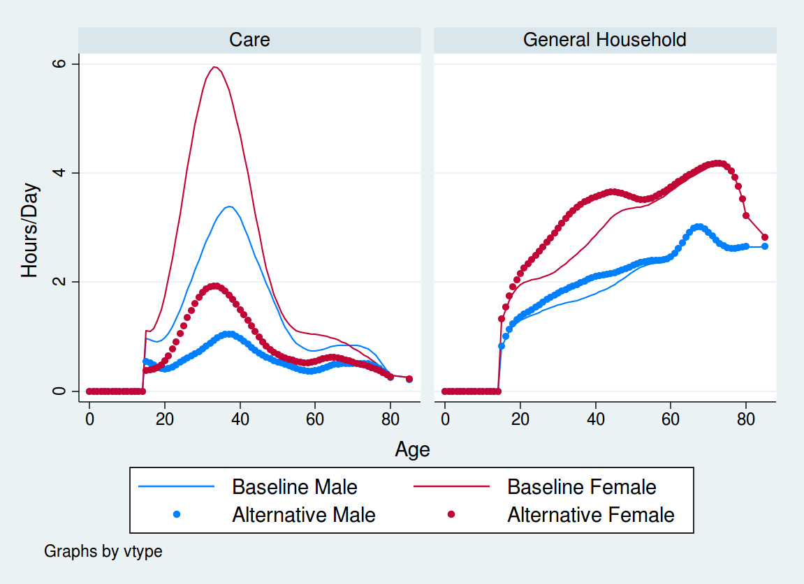
Multitasking
Production profiles in time units
Baseline:
Include
multitasking
Alternative:
No multitasking

Slide 10
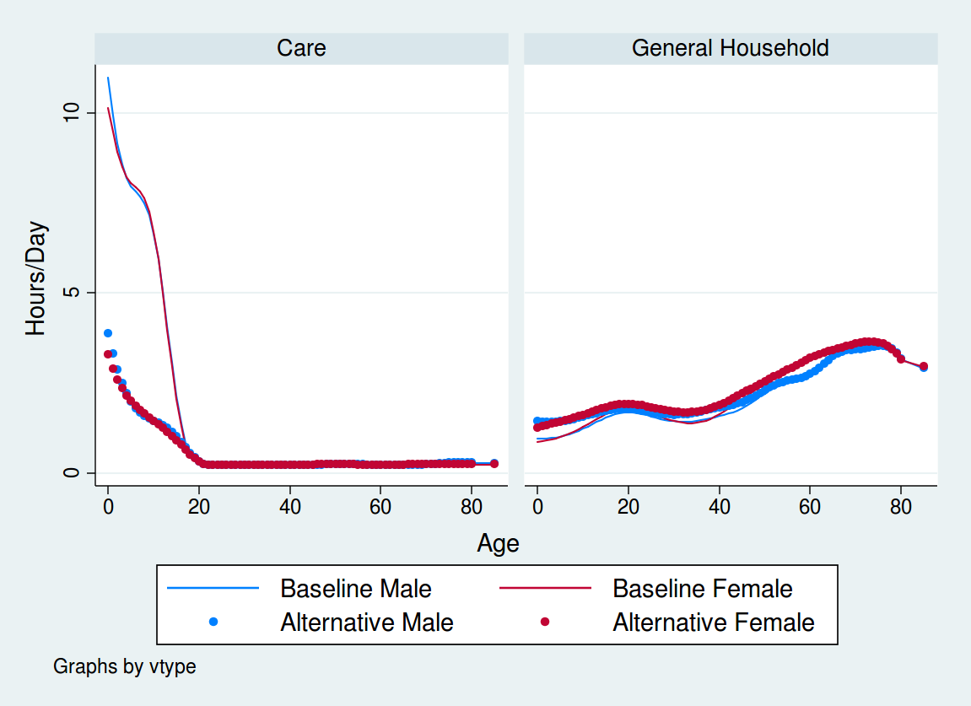
Multitasking
Consumption profiles in time units
Baseline:
Include
multitasking
Alternative:
No multitasking

Slide 11
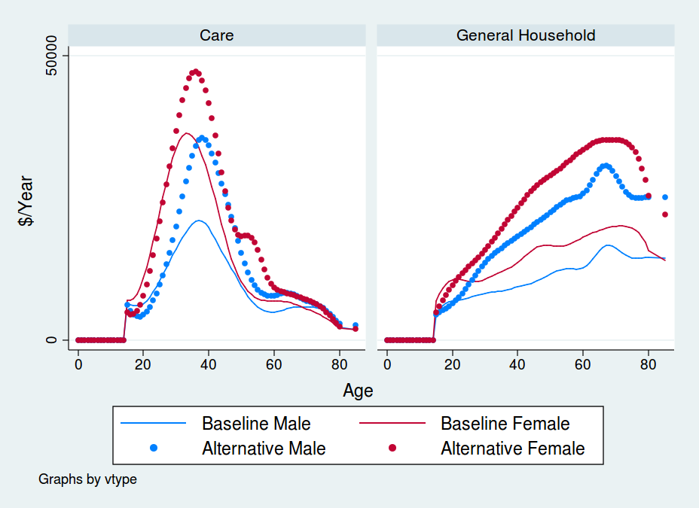
Wage Imputation
Production profiles in dollars
Baseline:
Specialist replacement wages
Alternative:
Opportunity cost wages

Slide 12
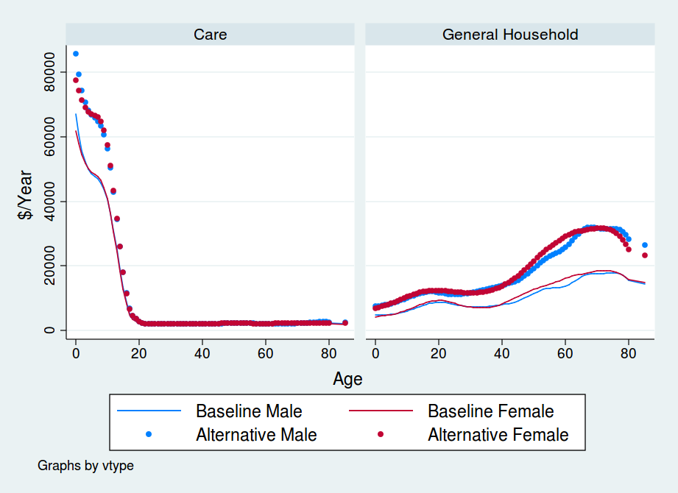
Wage Imputation
Consumptionprofiles in dollars
Baseline:
Specialist replacement wages
Alternative:
Opportunity cost wages

Slide 13
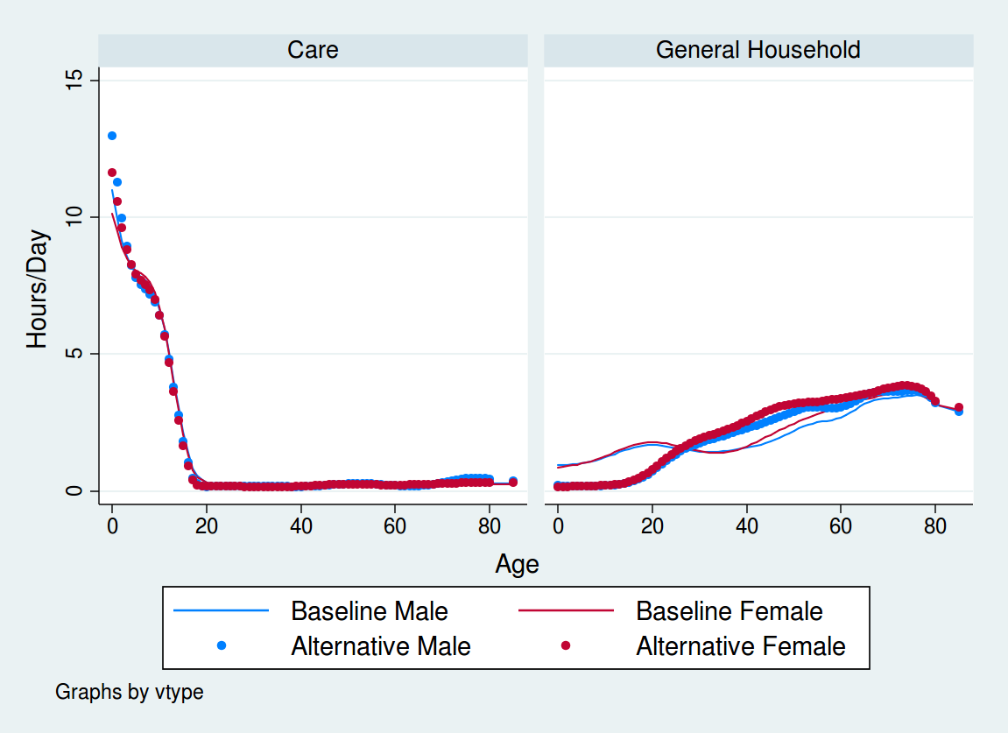
Consumption Allocation
Consumptionprofiles in time units
Baseline:
Equal allocation in target group
Alternative:
Regression determines allocations (except vol-unteering)

Slide 14
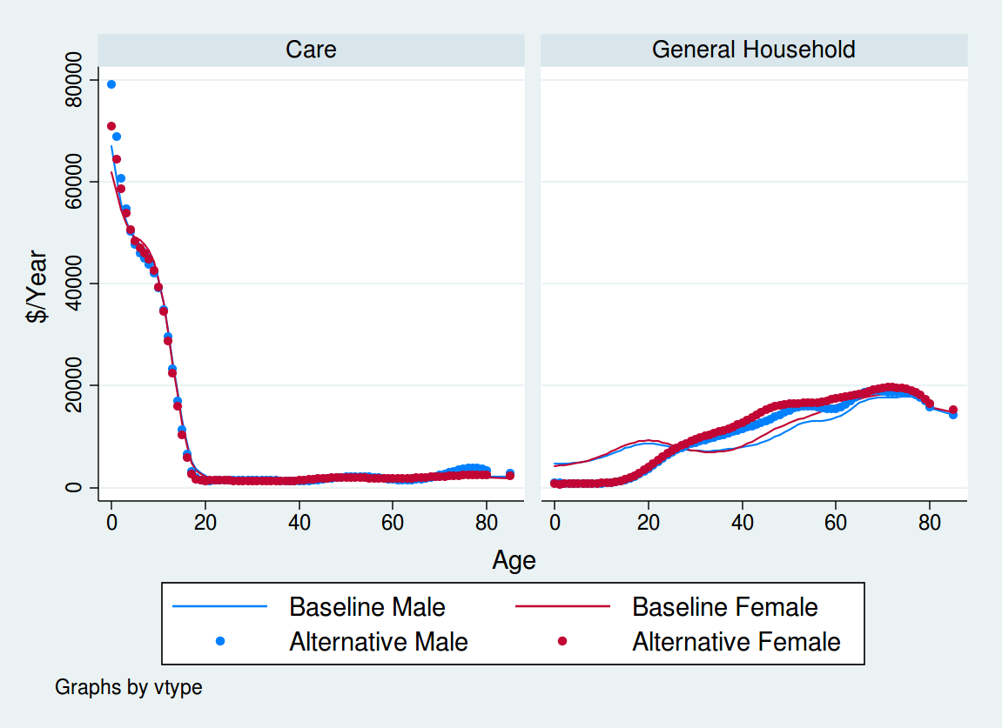
Consumption Allocation
Consumptionprofiles dollars
Baseline:
Equal allocation in target group
Alternative:
Regression determines allocations (except vol-unteering)

Slide 15
Consumption Allocation
Consumptionprofiles dollars
Baseline:
Equal allocation in target group
Alternative:
Regression determines allocations (except vol-unteering)

Slide 16
Regression and multitasking
Time (hours/day) consumed by 0 year olds:
If we include multitasking and regression, estimates seem to show “crowding out” of general household activities in households with babies. Is this misleading???
 | Boys |  | Girls
 | Care | Gen’l | Care | Gen’l
Baseline (multitasking and equal allocation to target) | 11.0 | 1.0 | 10.1 | 0.9
Changing methodology:
No multitasking | 3.9 | 1.4 | 3.3 | 1.3
Regression allocation | 13.0 | 0.2 | 11.6 | 0.2
Regression AND no multitasking | 5.3 | 0.9 | 4.3 | 0.8

Slide 17
NTTA Recommendations (?? Based only on US example)
Keep
Expansive activity definition
Adjustments for quality and fringe benefits
No age adjustment for productivity
Change
Multi-tasking: important, but many countries don’t have data, so any country with multi-tasking estimates should also make estimates with no multi-tasking
Wage imputation: implement modified opportunity cost for care only (adjusted by education of caregiver)
Consumption imputation: implement regression method for care but not general household activities

